Slide 1
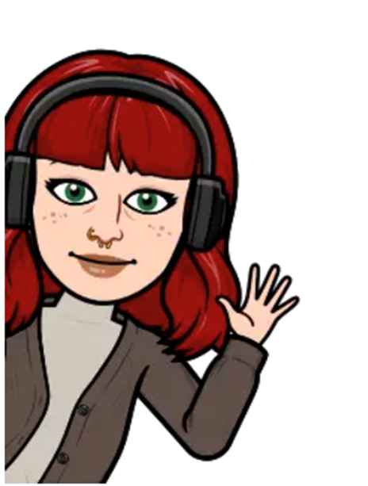
HANNAH
What people like about me
I listen to others and put myself in their shoes
I am caring
I love helping people
I don’t give up
Things important to me?
Spending time with people I love
Cats
A good first cup of tea in the morning
Patterned socks
What we might do
I will see you at home or at school and we can introduce ourselves and get to know each other. We can talk about the things that we like and don’t like. I think we might have things in common!
We can do an activity that you enjoy like colouring or playing games and we will make it fun and relaxed so please try not to worry! I just want to see you and for you to be comfortable.
The most important thing is that you know that I am here to help you and we talk at your pace about the things that you want to talk about.
My job
I work with children and young people like you to make sure that you are safe and happy. I want to know your opinion on things that are happening and for you to tell me how you think I can help and what you want to change.
I will try to do everything that I can to help you and I will ask other people to help me like your parents, your school or the doctors so that we can all talk about how we can make sure that you are happier and feel loved and looked after.
I will make sure that I do this in a way which is best for you and your family depending on what you tell me, and you can tell me if you want me to do something different if you don’t think my ideas are working.
What happens if you don’t want to talk to me
I know that it is hard to talk to new people about things that are tricky, and it might not feel like the right day when I come. That is okay and I can come back on a different day in another place that you would prefer to see me where you are more comfortable.
It is really important that you feel safe to talk to me about anything that you would like to tell me and so that I know what is happening so I can help. So please let me know how we can do this in the best way for you!
Questions
If you have any questions, you can ask me, and I will be happy to answer or I will ask someone else on the team and get back to you if I don’t know the answer straight away.
My email address is h.valentine@bury.gov.uk

