Slide 1
Emotion Coaching

Slide 2

Why are we here today?
Notes:
Staff felt there were significant impact on their professional practice, own well-being and self regulation, and the behaviour of the children.
Led to - reduction in exclusions and reduced use of physical restraint by 50%

Slide 3
Benefits for children….
It helps them realise it is Ok to feel sad or angry but that some responses are inappropriate – so it gives children tools to help them cope with their feelings
It gives them (the children) choices and a way out of a difficult situation without confrontation
The children talk to each other about their feelings and they are more likely to calm down themselves
Releases huge burdens for some children who struggle with emotional control
Enables children to separate themselves from their behaviour – so they don’t label themselves as ‘naughty’
Rose, McGuire-Snieckus and Gilbert, 2014

Slide 4

Today’s session
Growing an emotional brain
Connecting emotionally
Healthy vs Toxic shame
Emotion coaching – what does it do?
Emotion coaching – 3 steps
Practice and script ideas
Objective: To understand Emotion Coaching and
be able to use it in your work
Notes:
RL
Approx an hour of the background and explanation and 30 minutes to practice at the end

Slide 5

Our Brains
Three parts to our brain, can be divided into upstairs and downstairs:
Neocortex – Thought
Limbic system – Emotion
Reptilian Brain – instinct/survival
http://www.mindful.org/how-to-teach-your-kids-about-the-brain/
Notes:
I think it’s important when we’re managing behaviour to understand the underlying brain functions which drive the behaviour
We have three parts to our brain...
These three parts of the brain intermingle and communicate, sometimes like a contentious committee. The Neocortex likes to think it is in the driver's seat, but the Limbic System and Reptilian brain exercise a lot of power. The Reptilian brain, by far the oldest and simplest, is responsible for our survival, but its choices are limited.
Instinctual options when confronted with a threat to survival:
Fight, Flight, Freeze (only recently recognized along with the first two)
Ok we’re going to look a bit more at the upstairs brain and how it’s split into the left and right brain. Is anyone familiar with Dan Siegel’s work on the whole brain child?

Slide 6
Being in the downstairs brain
Resting heart rate is 60-100 bpm
Children with emotional behavioural difficulties are often on the alert, meaning that they are already around 120 beats per minute to begin with
Heart rate during aggressive behaviour reaches as high as 147 beats per minute
This is part of the fight or flight response, where our brain goes into survival mode
Notes:
It’s worth being aware of where these children are coming from in terms of their levels of arousal. When we think about children in a calm state we expect them to feel as we do.
Our heart rate is a good indicator of how we’re feeling and is controlled by the reptilian brain – the downstairs brain.
Children with EBD are often hyper alert and already preparing for fight or flight mode which is why they trigger much more quickly than other children. That feeling of 0-10 in no time can be better understood when we realise that some children are never at 0 but are hanging around the 3-4 level with a heart rate of 120 bpm

Slide 7
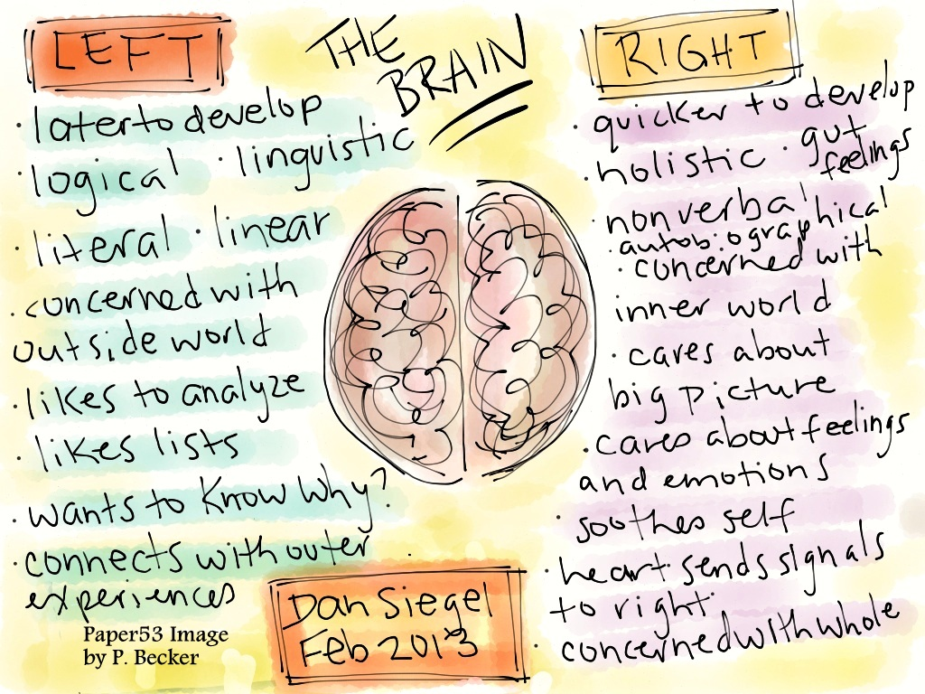
Connecting the upstairs and downstairs brain
Notes:
Ok we’re going to look a bit more at the upstairs brain and how it’s split into the left and right brain. Is anyone familiar with Dan Siegel’s work on the whole brain child?
So going back to our picture of the house we had two sides in the upstairs bit the right and the left.
The left brain – the Neocortex is where rational thought an planning occurs the right brain – the limbic system is where our emotional responses happen. In a moment of tension, difficulty frustration etc, the left brain is not calling the shots – the right brain is.
When we are faced with a difficult situation, we want children to make good choices but they cannot do this if they’re in their downstairs brain which is only concerned with fight, flight or freeze
In order to effectively manage our feelings and behaviour in difficult situations, we need to be in our upstairs brain – and we want the left and the right brain to integrate.
In order to connect with a child we need to help them integrate both sides by first connecting with the emotional brain

Slide 8
Integration
Stressful early relationships make it more difficult to establish neural pathways between the primitive (downstairs) and social (upstairs) parts of our brain
As helping adults, we need to support children to integrate their upstairs and downstairs brains
Instead of denying the feeling; empathise, label and validate
Neuroplasticity: https://www.youtube.com/watch?v=ELpfYCZa87g
Notes:
Every interaction is an opportunity to challenge or recreate what has gone before

Slide 9
Emotion Coaching
Much of today’s popular advice ignores the world of emotions. Instead it relies on child-rearing theories that address the child’s behaviour, but disregard the feelings that underlie the behaviour (Gottman, 1997).
Emotion coaching:
Prevents emotion dismissing.
Correlates with secure attachments; observed during positive parent interactions – approach that is natural/ intuitive rather than created.

Slide 10
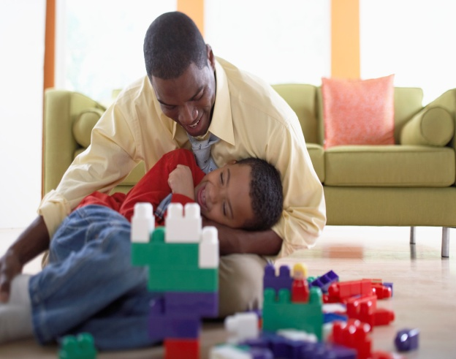
Parenting behaviours – the securely attached child
Sensitive to child’s emotional state
Responsive to signals of distress
Comforting
Available and engaging
Able to attune
Absorbs child’s protest
Protective
Provides secure base
Notes:
Held babies when their babies wanted to be held

Slide 11
How can difficulties occur?
Cognitive development
Communication skills
Impulsivity
Parents personal traits, expectations and reactions to a child’s behaviour.
Temperament
Sensory functioning

Slide 12
Emotional regulation can affect a variety of different areas:
Social skills (empathy/relationships with adults)
Cognitive skills (concentration & attention/ problem solving & flexibility/academic development)
Self-esteem

Slide 13
Emotional Development
Special Education Needs and Disabilities and emotional development:
    Language development
    Level of understanding
    What else?
Adapting our responses to fit with where our young person’s emotional regulation is at developmentally.

Slide 14

ACTIVITY
2 mins
Get into groups of three.
If you were feeling very distressed / out of control, what would you want a friend to do?
Prepare to feedback and discuss

Slide 15
Spot the difference
Dismissive Disapproving
Low empathy Low empathy
Low guidance High guidance
Laissez Faire Emotion Coaching
High empathy High empathy
Low guidance High guidance
Adapted from Janet Rose
Notes:
RH and RL
Get feedback from staff…..
Sounds like what you most want…….is lots of empathy, lots of understanding how terrible it is, how awful partner/ friend are etc….but also guidance, so you don’t go and do something that will get you in a lot of trouble
What you don’t want…..are your feelings or emotions being ignored, or being left to do something you’ll later regret……
High empathy and high guidance are what we want in situations when we feel out of control
……High empathy and high guidance are what we want in situations when we feel out of control…….and that’s what emotion coaching provides

Slide 16
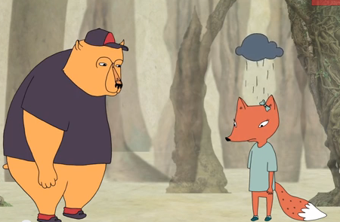
Empathy vs Sympathy

Slide 17
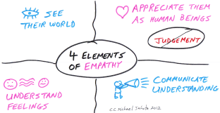
Connecting Emotionally
Empathy is always the place to start in order to help the child work from both sides of the upstairs brain
Emotional ‘first aid’ is needed first
Proposing solutions before empathising is like trying to build a house before you lay a firm foundation
Stop talking and listen – even when you don’t like the behaviour, acknowledge the feelings
CONNECTION BEFORE CORRECTION
RAPPORT BEFORE REASON
NAME IT, TO TAME IT
Notes:
RL
Connect ion before correction: when a child is upset, connect first emotionally, right brain to right brain. Then once the child is more in control and receptive, you can bring in the left brain lessons and discipline/consequences.
Validate – even when you don’t like the behaviour, acknowledge the feelings.
ALL feelings are normal, natural and acceptable – but negative behaviours are not.
Name it to Tame it: When right brain emotions are raging out of control, help children tell the story about what’s upsetting them. By doing this, they’ll use their left brain to make sense of their experience and feel more in control
SHORT TERM BENEFIT – moves child from reactivity to receptivity
LONG TERM BENEFIT– It builds the child’s brain
RELATIONAL BENEFIT – It deepens your relationship with the child
(Rose et al, 2014 quotes)

Slide 18
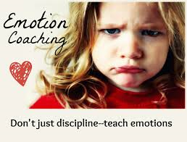
Connecting Emotionally
Emotion coaching builds a power base that is an emotional bond – this creates a safe haven, a place of trust, a place of respect, a place of acceptance
This is turn leads to CYP giving back respect, acceptance and boundaries
Notes:
Boundaries and warmth
Nurture and skill development

Slide 19

‘Healthy’ Shame
“Shame is an important dimension of socialisation but what matters equally is the recovery from shame. It is important to have a dose of cortisol, but it seems an “overdose” is extremely unhelpful”
(Gerhardt, 2004 p49).
Notes:
Shame is how we learn the process of what is right and wrong. Shame starts to develop when we are a toddler. There is a transition in the relationship between carer and toddler. As a baby, the interactions were on the whole positive as Carers spent most of their time tuning into the baby’s moods and responding to them. Through the process of socialisation a toddler requires the Carer to effectively become unattuned, to give the toddler the cold shoulder, to provide a disapproving look to indicate that the behaviour is unacceptable. The shame response is linked to the parasympathetic nervous system which is an inhibitory system and allows the child to stop doing what they are doing and learn what behaviour is acceptable. To develop this socialisation a certain amount of stress and shame is necessary. This allows for the neural pathways from the frontal cortex to the parasympathetic nervous system to be made.
Good enough parenting ensures that a child only feels short bursts of shame at significant times (for example, issues of safety, social acceptability) – link to quotation
‘I am bad’
LAC/adopted ch. likely to have a more easily activated shame response
Seek out people who will reinforce our sense of self

Slide 20

Toxic shame
Overwhelming feelings of shame
Internalised: ‘I am bad’
Often experienced globally rather than specifically
Notes:
Children with attachment difficulties can be overwhelmed by their sense of shame. They may have been excessively punished and humiliated for very natural and developmentally appropriate activities when they were younger. For example, being yelled at when they want to go to the toilet or for dropping or spilling something. They internalise this and see themselves as being bad and being the problem. Some of our approaches that we use to discipline children in school can bring these emotions to the fore and can escalate situations.
**WHAT STRATEGIES DO YOU HAVE FOR HELPING A CHILD RECOVER FROM FEELINGS OF SHAME?

Slide 21
Emotion coaching – what does it do?
Teaches children about emotions in the moment
Gives children strategies to help them deal with their emotional ups and downs
Accepts all emotions as normal
Uses moments of undesirable behaviour as opportunities for teaching
Builds relationships of trust and respect with children
Adapted from Janet Rose
Notes:
Prevents emotion dismissing – so children can link events to internal factors, not external control
Skill development and nurture – teaches the skills needed for emotional and behavioural self regulation
Every interaction is an opportunity to challenge or reinforce
Enables adults to communicate effectively and consistently with children in stressful situations.
Helps de-escalate situations and turn them into a learning opportunity.

Slide 22

Emotion coaching
External frameworks
External regulation (sanctions and rewards)
Internal frameworks
Internal regulation (emotion coaching)
Adapted from Janet Rose
Notes:
Builds on internal self-regulating framework
If deal with external frameworks, just what’s going on the outside – then you need external regulation, such as rewards and sanctions, which children habituate to, so need changing frequently to maintain interest and motivation.
If deal with internal frameworks and what is going on inside – by co-regulation with that child – they will understand their feelings, emotions and behaviours better and so be better equipped to deal with them – in this way they can develop internal regulation and manage their feelings independently.
Interdependence leads to independence
“ It helps pupils regulate their own behaviour and deal with them more independently – in the long run it will save you time because the pupils will be able to manage their feelings themselves (Rose et al, 2014)

Slide 23
The 3 Steps of Emotion Coaching
Acknowledge Feeling: “I understand how you feel. You’re not alone.”
(You need Step 1 to help the child become calm, so they can engage with you for Steps 2 and 3)
2. Limit Set: “We can’t always get what we want.”
Problem Solve: “We can sort this out.”
Adapted from Janet Rose

Slide 24

Step 1: Empathise, validate and label
Recognise all emotions as being natural and normal and not always a matter of choice
Recognise the behaviour as communication
Look for physical and verbal signs of the emotion being felt
Take on the child’s perspective
Use words to reflect back child’s emotions and help the CYP to label the emotion
Empathise and provide a narrative/ translation for the emotional experience
Notes:
Instead of denying the feeling…..empathise, acknowledge and label.
This step is crucial for bringing arousal levels down, so they can then engage in problem solving – watch the child, you may need to repeat this step a couple of times before moving on
Wondering aloud – I wonder if……less threatening that stating how you think they feel
If tell you they feel a different emotion – opportunity to work with that
Provides an opportunity to develop their emotional vocabulary……

Slide 25

Just angry?.......
Angry
aggravated
annoyed
defiant
disgusted
enraged
exasperated
frustrated
furious
hateful
hostile
indignant
infuriated
mad
obstinate
outraged
perturbed
peeved
pissed off
rebellious
seething
spiteful
surly
upset
vengeful
Ashamed
apologetic
embarrassed
foolish
guilty
humble
idiotic
mortified
regretful
remorseful
shameful
worthless
weepy
Satisfied
adequate
content
mellow
peaceful
pleased
Scared
afraid
alarmed
fearful
frightened
horrified
hysterical
insecure
intimidated
nervous
panicky
petrified
terrified
threatened
vulnerable
Surprised
aghast
amazed
astonished
astounded
incredulous
shocked
startled
Thankful
appreciative
grateful
gratified
indebted
obliged
relieved
Thoughtful
challenged
curious
illuminated
informed
interested
pensive
reflective
Uncertain
cynical
doubtful
dubious
distrustful
hesitant
indecisive
pessimistic
skeptical
suspicious
unsure
unsettled
Uncaring
ambivalent
apathetic
bored
busy
detached
exhausted
indifferent
lethargic
lazy
tired
unmotivated
nonchalant
occupied
Selfish
Confident
bold
capable
centered
eager
energetic
focused
grounded
hopeful
inspired
keen
optimistic
powerful
productive
strong
sure
trusting
Confused
baffled
befuddled
bewildered
disoriented
flustered
perplexed
puzzled
scattered
troubled
unfocused
Happy
amused
cheerful
delighted
ecstatic
elated
excited
exuberant
gleeful
high
joyful
mischievous
Hurt
abandoned
abused
attacked
belittled
bitter
cheated
disappointed
dismayed
grieving
gypped
humiliated
mournful
sorrowful
rejected
resentful
Loving
affectionate
aroused
caring
devoted
intimate
tender
warm
Sad
despondent
depressed
dismal
low
melancholy
miserable
unhappy
Wanting
empty
envious
homesick
hungry
ignored
jealous
lonely
longing
lustful
Weak
inadequate
burdened
controlled
despairing
discouraged
helpless
hopeless
impotent
inhibited
lost
passive
powerless
restricted
suicidal
Worried
agitated
anxious
bothered
restless
tense
uneasy
unsettled
Notes:
Lots of feelings!!
Children often have limited feeling vocabulary – lack the ‘greys’ - report being angry, when in fact they maybe annoyed, irritated, envious, empty, sad, fearful etc.....
Emotions and feelings are often spoken of as being one and the same, and it’s easy to get them mixed up and confused. Although related, there is a difference between
'Feelings' in a general sense, are what we may feel in any part of our body. These may be simple body sensations, such as hot or cold, pain, a touch or else they may be feelings associated with emotions, such as love or hate, joy or anger. We may also deliberately produce feelings as in meditation and feel and radiate love or compassion to our planet or humanity or groups or individuals. I do not regard these as emotions.
'Emotions', on the other hand, are feelings or reactions about someone or something, and usually involving our vaules. We are angry about someone, afraid of something, in love with someone. These emotions may be directly felt in the body or we may just react strongly with thoughts or words - we may have a strong reaction without actually being aware of a feeling in the body.
Feelings are Low-key but Sustainable.
Emotions are Intense but Temporary.
Happiness: is a feeling. Joy: is an emotion.
Worry: is a feeling. Fear: is an emotion.

Slide 26
Step 1: Examples
‘I can see that you get angry when that happens. I would feel angry if that happened to me. It’s normal to feel like that’.
‘I can see you’re frowning and I’m wondering if you’re feeling worried’.
‘I think you might be feeling fed up about not being able to play football now. I know that’s not nice for you’.
Notes:
Whoa, you’re angry!
It’s so annoying when someone….
You’re probably feeling worried……
I’d be nervous / worried/ annoyed / sad if……
I think you might be feeling……
Know the child – what their triggers are…..likely responses…..and their language levels

Slide 27
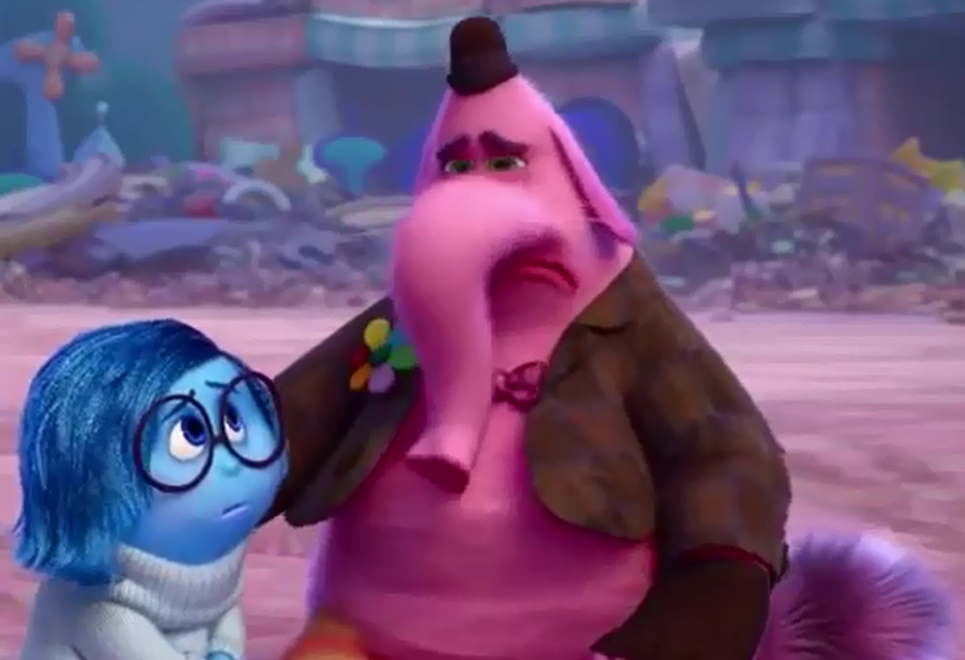
Step 1: Empathise, validate and label

Slide 28

2: Limit set
State the boundary limits of acceptable behaviour (if needed)
Make it clear certain behaviours cannot be accepted
But retain the child’s self-dignity (crucial for responsive behaviour and well-being)
Notes:
Don’t always need this step
Link back to toxic shame covered earlier

Slide 29
Step 2: Examples
‘These are the rules that we have to follow. Doing that is not ok’.
We can’t behave like that even though you are feeling annoyed because it is not safe’.
‘You didn’t put the ball away as we agreed. You’re probably angry that you can’t play with Billy now because you have to stop’.

Slide 30

3: Problem solve with the child
When the child is calm and in a relaxed, rational state:
  Explore the feelings that give rise to the behaviour/ problem/ incident
  Scaffold alternative ideas and actions that could lead to more appropriate and productive outcomes
  Empower the child to believe s/he can
  overcome difficulties and manage feelings
Notes:
Help the child to see that you are there alongside them – to help them with these tricky times…….and that it will get better; you’ll help them find new ways to react/ behaviour and with practice they will get there.
It might be scary/ really hard for them now, but they are not alone – and there is an alternative

Slide 31
Step 3: Examples
‘This is not a safe place to be angry. Let’s go to a safe place and then we can talk’.
‘Next time you’re feeling like this, what could you do? How do you think you will react next time or if it happens again?’
‘We need to figure out what to do next time. Have you got any ideas’
Notes:
PICC Model – coping power
Insight – help to understand their own feelings and responses to situations
Repair – way back – what they can do to make things right
An alternative

Slide 32
Keeping yourself in the upstairs brain
Children with oppositional behaviour seem to be able to send us from the upstairs brain to the downstairs brain in no time!!
We are conditioned to react immediately in order to rectify the situation and maintain order
We need to remain in our upstairs brain in order to support children to be there too
What strategies do you use?
Notes:
Self regulation before co-regulation
Put on an oxygen mask before putting it on the child!

Slide 33
Ice Cream
Notes:
What’s child doing in the first picture – swinging on the chair. – What would Dad say if he saw this?
Look at the ice cream.
2. The ice cream ins on the floor

Slide 34
Ice Cream
Notes:
Never mind - the boy feels his Dad doesn’t understand. To him it’s a very big deal. His cries get louder.
Dad thinks so much fuss about nothing and he shouldn’t have been rocking on his chair. Not seeing it from the boy’s perspective which is quite different
Dad’s stern voice are more than the boy can take (first no ice-cream and now Dad is angry). Boy cries more.

Slide 35
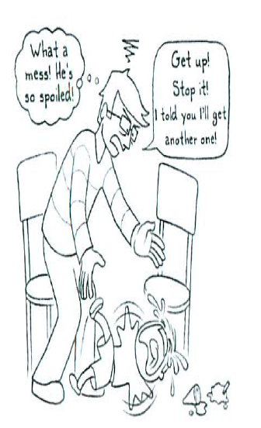
Notes:
Dad’s offer is too late – the boy is already in a highly emotive state and can hardly understand what Dad is saying. Then he’s on the floor kicking and screaming not really caring about the ice cream anymore.

Slide 36
Mountain of anger
Notes:
What’s happened – Something went wrong for the boy and his alarm system was triggered. Dad was unsuccessful in calming him down and the boy became even more frustrated. Both Dad and the boy became upset at each other’s responses until they ended up at the top of the mountain.
Upset is normal - the Dad’s attempt to stop his child from being disappointed made the situation worse. Dad was trying to stop his son from having natural feelings which is impossible and undesirable. Unpleasant feelings are normal adn healthy reactions to disappointments and frustrations. Being upset is part of life. While crying and shouting are unpleasant for parents to see, they are a child’ normal and healthy way for releasing their emotions.

Slide 37
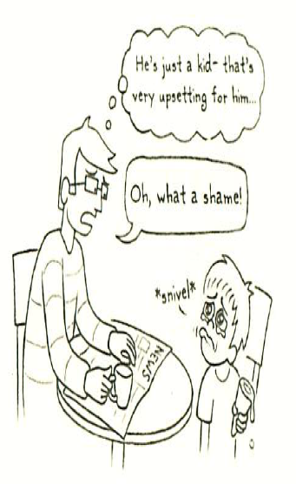
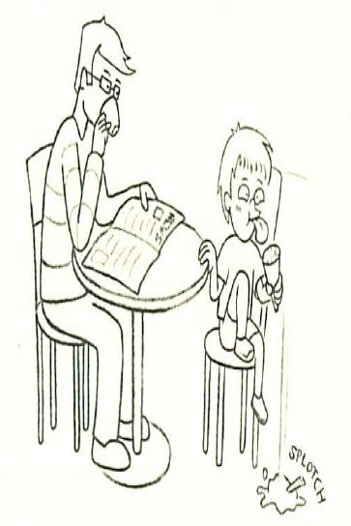
Ice Cream Example
Notes:
*******************
Pictures from page 83 - 85

Slide 38
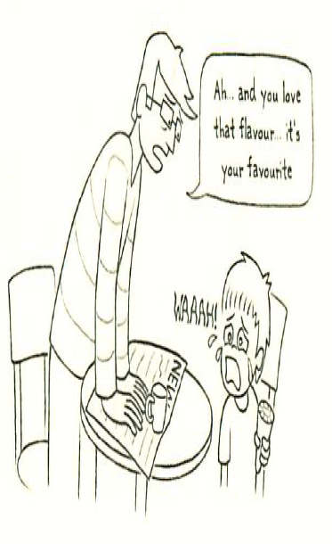
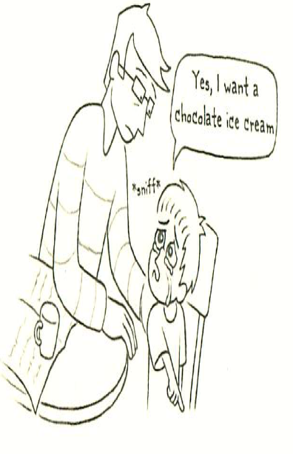

Slide 39
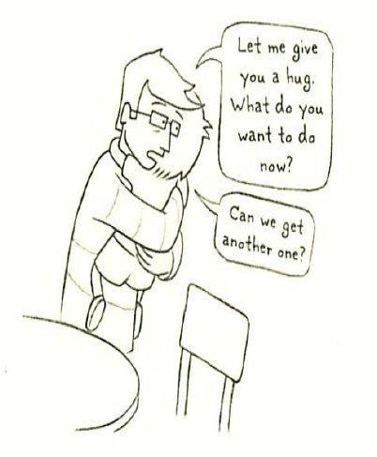

Slide 40
Childish
Childish | Possible meaning in English
No. I don’t want to. I won’t do it. You can’t make me. | I’m not sure what you want and I’m too embarrassed to ask. I know what you want but it seems too hard and I feel I may fail. I’m worries or scared about doing it. I really don’t want to do this because I am tired/hungry/have other things I want to do.
It’s boring. | It’s difficult and I’m not sure I can do it. I don’t see the point of it. It is not ‘cool’ – my friends may look down on me. I don’t like it.
It’s not fair. | I don’t like it. Someone else is having something that I feel should be mine. You promised this to me and now you are not keeping your promise.
You are so mean. | I’m frustrated with you because you are stopping me from doing what I want. I feel that you are winning and I’m losing.
I hate you. | I’m so furious that I don’t know what to do or say. I feel humiliated.
I don’t love you anymore! You are not my mum! | I am so frustrated, confused and unhappy and I don’t know what to do or say anymore. I need you to love me whatever I do.

Slide 41


Thank you!
Any questions?

