Slide 1
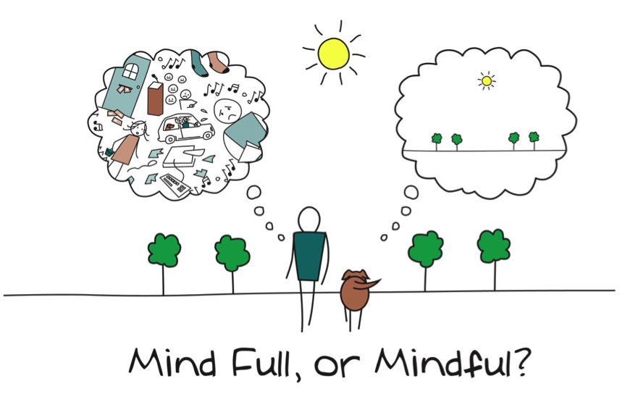
Mindfulness in the Early Years

Slide 2
What is on your mind?
Think of something that is on your mind; write it down; screw it up/ rip it up and throw it away and relax and enjoy the session

Slide 3
Aims
To understand the notion of what mindfulness is.
To understand the benefits of using mindfulness for young children.
To practice some mindfulness techniques for young children.
To identify and discuss how mindfulness can be used in the Early Years.

Slide 4
Group Agreement
Respect each other
Trust/ Confidentiality
Make sure everyone gets a chance to speak
Be responsible for getting your needs met
Be willing to experiment
Bring and share your ideas
Only join in with what you feel comfortable with
Check in with group members or facilitator

Slide 5
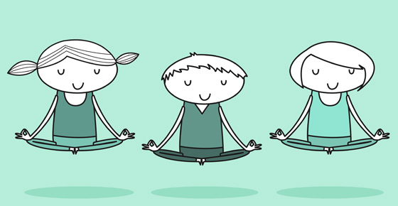
What is mindfulness?
Mindfulness refers to ‘the awareness that emerges through paying attention on purpose, in the present moment and non-judgementally to the unfolding experience moment by moment’ (Kabat-Zinn, 2003 p.145)

Slide 6
Features of mindfulness
Attention to the present moment
Awareness
Self-compassion
Non-judgement
Patience
Beginner’s mind
Trust
Non-striving
Acceptance
Letting go
Notes:
Give a very brief overview.

Slide 7
Mindfulness in schools/ organisations
Recognised by NICE and is increasingly used in preventative and well-being programmes
Ofsted Framework (2015)- schools have a duty to support children’s well-being and mental health.
Recent large scale systematic literature review (Maynard et al.,2017) indicates benefits to children’s cognitive skills (e.g. executive function, memory, attention) and social-emotional wellbeing (e.g. reductions in anxiety, stress, internalizing behaviours, improved social skills, self-regulation, self-esteem and engagement)

Slide 8
Mindfulness in the Early Years
Growing attention in terms of using mindfulness in the Early Years.
Research demonstrates increasing numbers of children with attention difficulties at a young age (DiCarlo et al., 2016; Rabiner, Godwin & Dodge, 2016).
Children with attention and listening difficulties are often at risk of poorer outcomes.
Emerging research indicates that mindfulness is beneficial for not only improving attention but children’s social, emotional and mental health needs.
Mindfulness may be a useful form of early intervention and prevention.

Slide 9
Breathing Inquiry
Noticing the breath
Breathing with the pinwheel (Kindness curriculum)
Place hand on your belly and take a nice deep breath in feeling your tummy rise, and when you are ready breathe out feeling your belly fall.
Introduce pinwheel – Feel your belly fill with air and then breathe out.
Encourage the children to practice and observe what they are doing.
Another useful activity is Belly Breathing
Lie down in a comfortable position on the floor. Place a stuffed toy on your belly and breathe as you usually would. Notice what happens as you breathe. Our tummy and belly buddy rises as we breathe in, and falls as we breathe out.

Slide 10
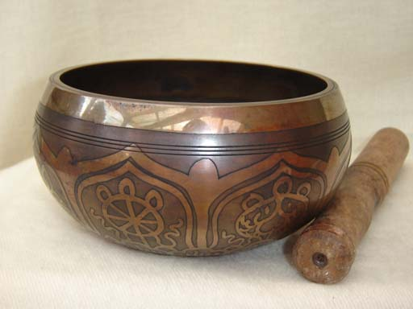
Listening for the bell
As well as noticing what is happening on the inside, we can pay attention to what is happening around us through the help of the bell.
To start with, you may wish to hit the singing bowl and invite the children to raise their hands when they can no longer hear it. Afterwards, encourage the children to take some nice deep breaths and relax.

Slide 11
Breath Inquiry
During these activities you can lower the lights and play some gentle music.
You may wish to leave a minute for reflections e.g. ‘how do you feel when you just pay attention to your breathing?’
You may wish to explain when you use breathing exercises and why e.g. “Breathing exercises can help you to calm down when you are upset or nervous, and can help you to focus better”.

Slide 12
Guided Imagery
YouTube
‘Enchanted Meditations for kids’ by Christine Kerr

Slide 13
Tips for writing guided imagery
Writing your own scripts
Structure:
Getting comfortable
Start with a general relaxation (visualisations and/or breathing exercises)
Using the countdown technique (slowly counting down from 5 to 1)
The Journey (describing the environment that you wish the listener to experience. As you do so, attempt to involve the listener’s senses. Describe what can be seen, smelled, heard and touched. The more the listener can connect their senses to the environment you describe, the more deeply they will become immersed in the journey).
The Return

Slide 14
Tips for reading guided imagery
Reading your scripts
Be Relaxed To Help Relax
Set the Stage
Mind the Volume
Set the Pace
Sense Your Child’s Response
Notes:
Be Relaxed To Help Relax: When doing any sort of guided imagery, it is important to be in that space first before you attempt to guide anyone else. Energy is important! Your child will be able to feel if you are truly relaxed and at peace or not. If you feel edgy or tense, it’s best to wait until you feel more centered before you guide your child in a guided imagery. Perhaps do a quick deep breathing or centering activity first to get grounded and feel at peace. Remember to deeply enjoy. If you have the energy of “have to” or are attached to a specific response from your child, then it’s best to wait until you are doing it for your own deep enjoyment.
Set the Stage: Set up an environment that is safe, secure, comfortable and free of distractions. Energy is everything! Make sure that you and your child feel good in the environment. It’s also important that it hasn’t been associated previously with negative events, this can be a distraction and counterproductive for relaxing. Create a special place where you can practice every time, this may include a space such as a pop up tent or in bed. You can ask your child to help create this space with you. Add items that are meaningful and may represent this time, such as a soft toy. It is also helpful to add soft things, such as pillows and blankets.
Mind the Volume: Read with a soft, but clearly audible voice. If you are whispering or talking too slowly, it can be distracting for your child since she has to struggle to actually hear what you are saying. On the flip side, if you speak to harsh or have a naturally loud voice, you might need to mindfully focus on softening your tone as you lead the activity.
Set the Pace: Read slowly and steadily, giving your child a pace that allows them to really experience what you are leading them into in their imagination. Sometimes it is good to practice recording yourself and listen back, participating in your own guidance, before leading someone else. Often, I have found that while I thought I was going slow, I was actually moving along a bit too quickly. If you are participating in the guided imagery while you are leading it, it helps. Not only are you getting into a very relaxed place, but you can follow along with your child’s experience.
Sense Your Child’s Response: Sense your child’s response as you are guiding, if she is feeling more tense, pause and ask how she is and adjust accordingly. With practice, you will be able to feel how your child is responding, if she is getting more relaxed or not.

Slide 15
Action planning
What are you going to do next?
Have a go…
Notes:
Including more workshops / activities / reviewing the project

