Slide 1
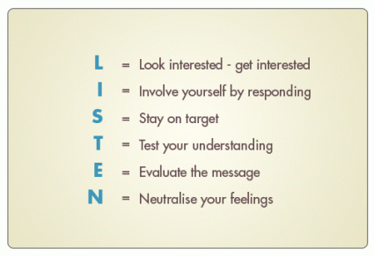
SEND Toolkit
Social, Emotional and Mental Health
Understanding behaviour strategies
Active Listening and Planned Ignoring
Active listening is based on empathy
We should be engaged and attentive to what is being spoken
When we use active listening, we reflect back the child’s feelings but we don’t try to fix things for him/her.
Our demonstration of trust gives him the courage to look for solutions to his own problem.
The simple act of identifying and validating a child’s emotions can diffuse anger, clarify needs, and open the child up to possible solutions.

Slide 2
SEND Toolkit
Social, Emotional and Mental Health
Understanding behaviour strategies
Active Listening and Planned Ignoring
Attention from others gives us a profound sense of belonging and therefore it is important that we are attentive towards children.
However, the need for such attention means that children will sometimes do whatever they can to get it, even if this means negative attention.
Usually the child will begin to use their most dominant behaviour to gain attention as this is likely to work if the child is persistent enough.
Before using this technique, we must decide whether children are actually using a particular behaviour to gain attention or whether it could be a ‘cry for help’. Ensure you have carefully observed over a number of weeks before adopting planned ignoring
Be clear on which behaviour you are targeting rather than a blanket approach
Planned ignoring works in partnership with active listening

Slide 3
SEND Toolkit
Social, Emotional and Mental Health
Understanding behaviour strategies
Active Listening and Planned Ignoring
Strategy guide:
Attention: You never ignore the child, just the behaviour
It is usually appropriate to decide on the behaviour you have decided to ignore otherwise you can easily fall into the trap of ignoring the child
Be clear that the behaviour is being used to gain attention rather than any other reason
In agreement with the whole team, you pay no attention whatsoever to the behaviour.
No verbal, body language or physical acknowledgement of the behaviour should be given (this includes acknowledged glances towards colleagues to note the behaviour as children can read these signals)
You match this with positive reinforcement therefore give lots of attention to positive behaviours
Eventually, the child will begin to acknowledge positive behaviour with positive attention and the undesirable behaviour should minimise.
This method should result in improved self esteem of the child and practitioner and build trusting relationships that are respectful.

